Slide 1
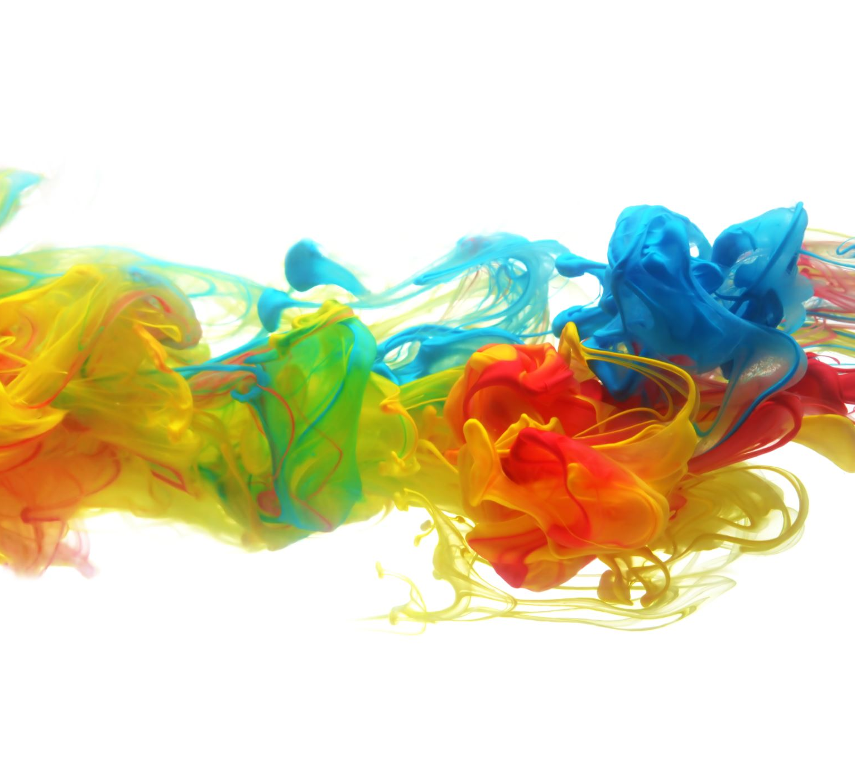
<Product Name>
Team name

Slide 2
Instructions
11/16 – Present draft run to your instructor
11/30 – Presenting to the entire class
Total run time:
Dry presentation and demo is 7 minutes to present and demo
Final presentation and demo is 7 to 12 minutes to present and demo
Please cover the topics in the agenda slide below

Slide 3
Dry Run Agenda
What problem will you solve?
How will you solve it?
Who is your customer and their personas
What are your two scenario demos
Demos
Team Introduction
Names & pictures
Who did what roles
What would be next steps be done in this project?

Slide 4
Final Agenda
What problem will you solve?
How will you solve it?
Who is your customer and their personas
What are your two scenario demos
Demos
Team Introduction
Names & pictures
Who did what roles
What would be next steps be done in this project?
What you learned from this course
About yourselves
About software development/Agile Process/Teams
What you would do differently in your next project/team

